Slide 1
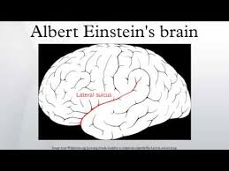
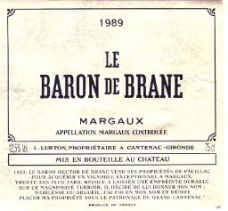
Einstein’s Brane
Zurich, November 13, 2015
Not his brain!
Nor his favorite tipple!
Paul K. Townsend
Department of Applied Mathematics and Theoretical Physics
Centre for Mathematical Sciences, Cambridge University

Slide 2
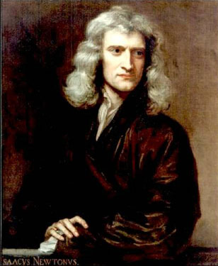
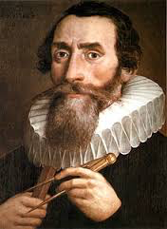
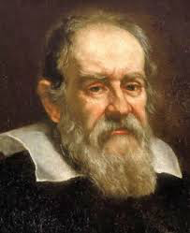
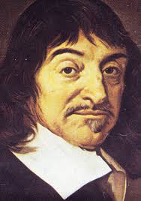
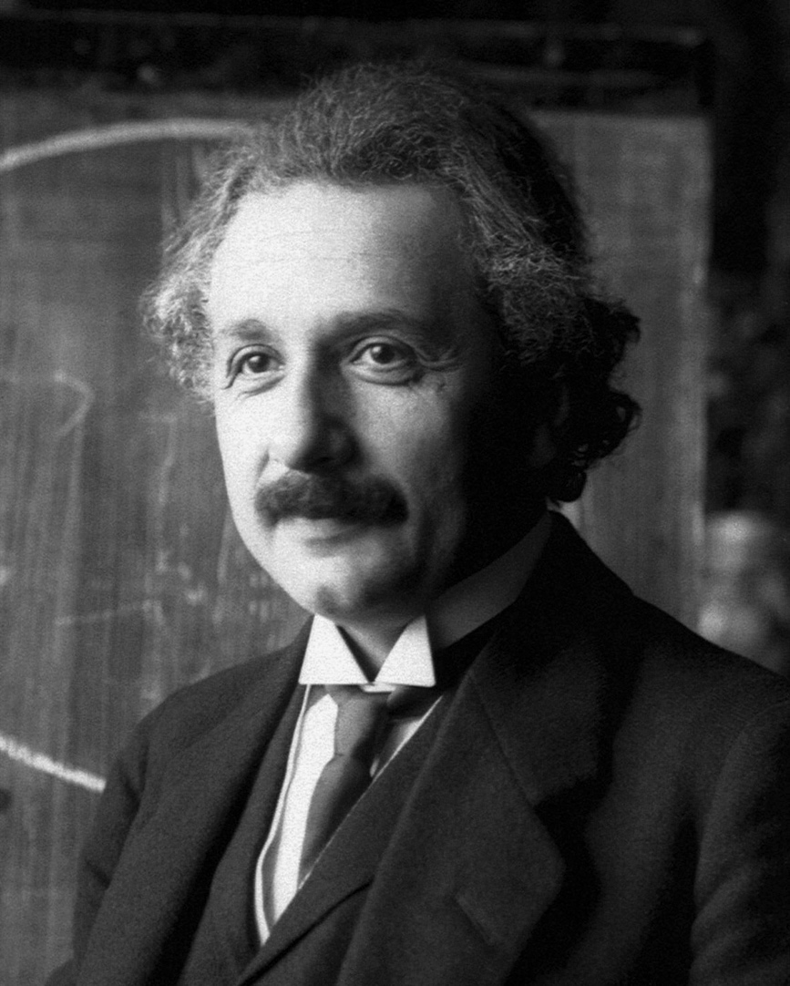
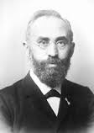
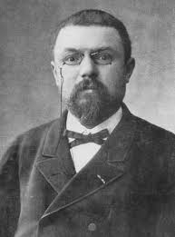
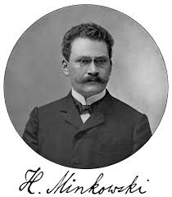
Relativity
&
GRAVITY
1616
1632
1642
1687
17th Century
20th Century
1904
1905
1907
1915

Slide 3
1905 Special Relativity
E= mc²
SPEED OF LIGHT
1915 General Relativity
NEWTON’S
GRAVITATIONAL
CONSTANT
G_{mn} ⁼ 8π G T_{mn}
Gravitational
Waves
1917 Cosmology
EINSTEIN’S
COSMOLOGICAL
CONSTANT
G_{mn} + Λ g_{mn} = 8πG T_{mn}

Slide 4
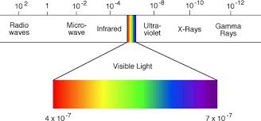
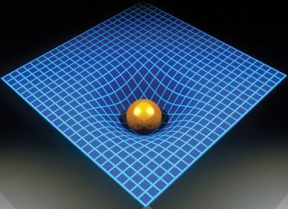
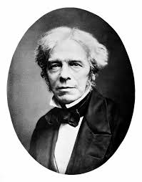
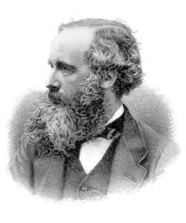
Known Forces of Nature, circa 1916
Gravity as a field theory
Electromagnetic
field theory
What’s next?

Slide 5
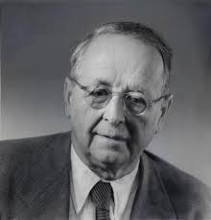
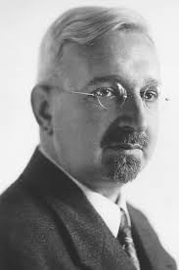
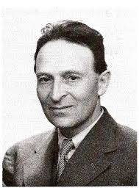
UNIFIED FIELD THEORY ?
Weyl, 1918
Kaluza, 1921
Klein, 1926
Gauge Invariance
Extra space dimensions
Some good ideas
but
many ingredients
are missing!
Einstein 1925 →

Slide 6
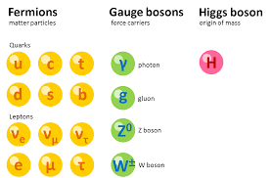
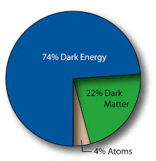
The Ingredients
GRAVITON:
Quantum of
Gravitational
wave
DARK
MATTER
+
+
Quantum of
Electromagnetic
wave
Three ``families’’ of
elementary particles!
DARK
ENERGY
+
=

Slide 7
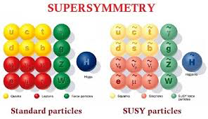
TWO GIFTS FROM the SEVENTIES
SUPERSYMMETRY
•
Unifies matter and forces
Not (yet) seen!
QUANTUM STRINGS
•
``Predicts’’ Gravity (includes graviton)
•
Requires 6 extra dimensions
(and supersymmetry)

Slide 8
Ideal Strings
Uniform mass density ρ
(kg/m)
Uniform tension T
(Newtons)
Small amplitude wave:
v
v² = T/ρ
String
T ≤ ρc²
v ≤ c
➔
(Energy density)

Slide 9
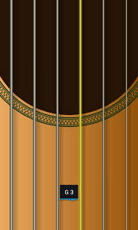
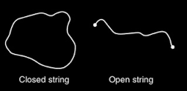
Kinds of string
Spool of thread
T = 0
Guitar Strings
T << ρc²
Energy density
String Theory
Strings
T = ρc²

Slide 10
Closed Strings
Lowest oscillation state is the graviton
Quantum Gravity
But, need supersymmetry AND 9 space dimensions
Superstring Theory
The
1980s
There are just five of these

Slide 11
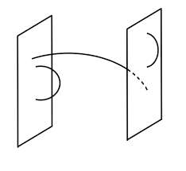
Open Strings
Open strings end on branes:
For example
a membrane
(extended in 2
space dimensions)

Slide 12
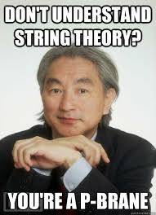
p-Branes
String
p=1.
p=2.
p=3.
p=4 .......
Membrane
Three-brane
Space filling!
possible with extra space dimensions!

Slide 13
Kinds of Branes
Mass density ρ
Surface Tension T
T
T ≤ ρc²
T
T
e.g. a drum
T << ρc²
T
T
String theory branes saturate the bound:
T= ρc²

Slide 14
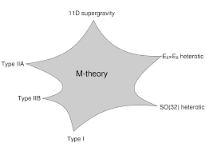
1990s
M-Theory :
the unification of
superstring theories
Now, even strings are really branes
Membrane in 10 space dimensions
Kaluza-Klein
at work
String in 9 space dimensions

Slide 15
Brane Democracy
In M-Theory, all branes are equal
(but some are more equal than others)
That’s because they are
all made from the same
T= ρc² ``stuff’’
String
3-brane
(for example)
Supersymmetry
``justifies’’
these pictures

Slide 16
Brane-World
Particles are quanta of fluctuations of branes
.
Higgs boson
electron
.
.
.
Quark
positron
Multiple Branes

Slide 17
BRANES vs BULK
Branes
Interact only
via gravity
Dark
Matter
BULK

Slide 18
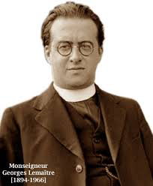
Dark Energy
Simplest explanation: Einstein’s cosmological constant Λ
Equivalent to filling space with a T= ρc² tensile materiala
A three-brane !
Vos calculs sont corrects mais votre physique est abominable
Georges Lemaître
1927

Slide 19
Why is Gravity different?
Gravity resists unification with other
forces of nature.
As formulated by Einstein, it appears
incompatible with Quantum Mechanics
M-theory explains why:
Gravity governs the dynamics of the BULK
Other forces act only on BRANES

Slide 20
What is the BULK?
Modern idea: it emerges holographically from quantum fields on branes
Holograph
image
fuzzy
image
Brane
Bulk

Slide 21
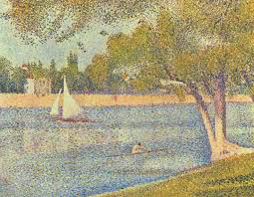
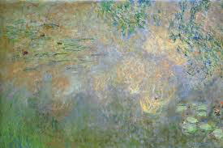
Pointillism vs Ondulism
Seurat
Monet
Brane
Bulk

